Slide 1
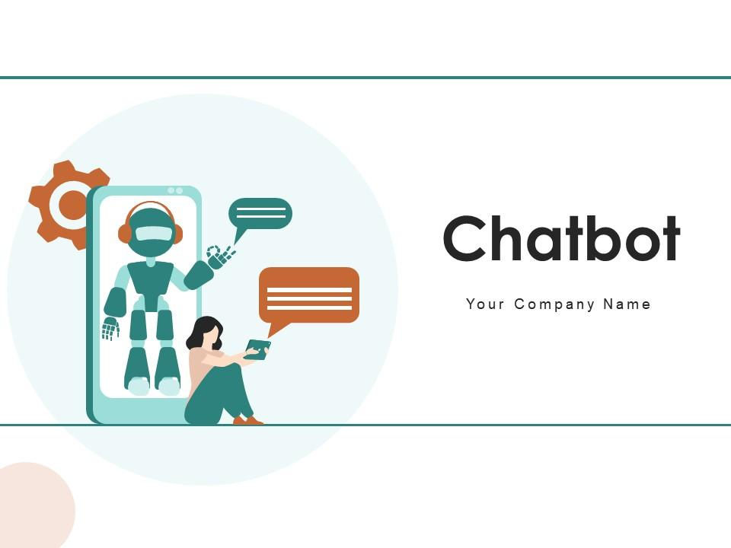
Q&A Chatbot
by
Kaiyuan Wei
Zhenghao Shi
Yu Zou
Course CS6120

Slide 2
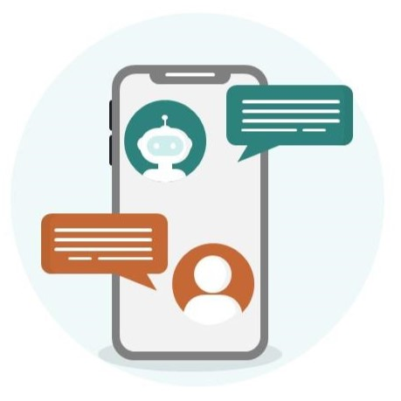
Description
In the project, we designed a simple Chat Bot can answer a simple question based on the given story.
For example:
Context: Tom went to bookstore. Jerry is in the kitchen.
Question: Is Jerry in the bookstore?
Chatbot: No.
The Chat Bot can make some degree of prediction, but still far away from capable of answering complex questions.

Slide 3
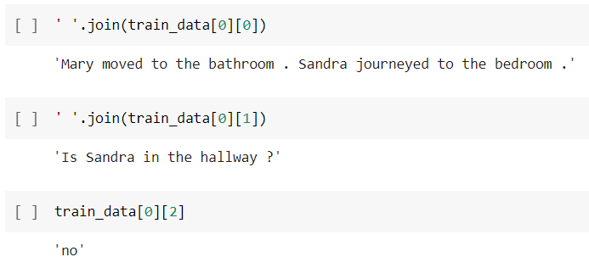
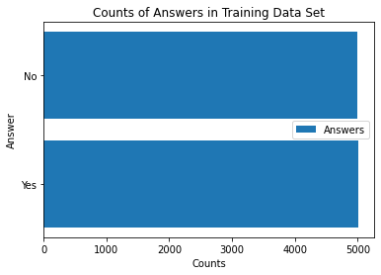
Data Used
We used the bAbI dataset from Meta research webpage.
The data including 11,000 pieces of data. Each data has 3 parts: context[0] [0], question[0] [1] and answer[0] [2].
Used 10,000 for training and 1,000 for testing.
https://research.facebook.com/downloads/babi/

Slide 4
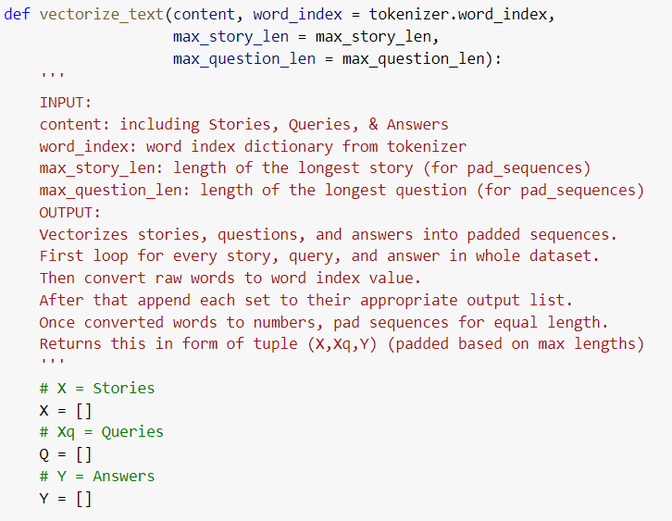
Text Vectorizing

Slide 5
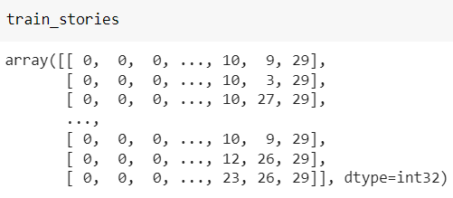
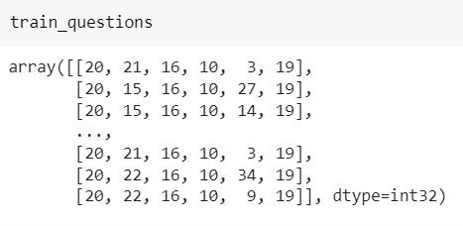
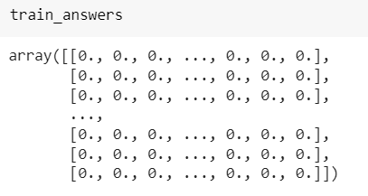
Outcome of Vectorization

Slide 6
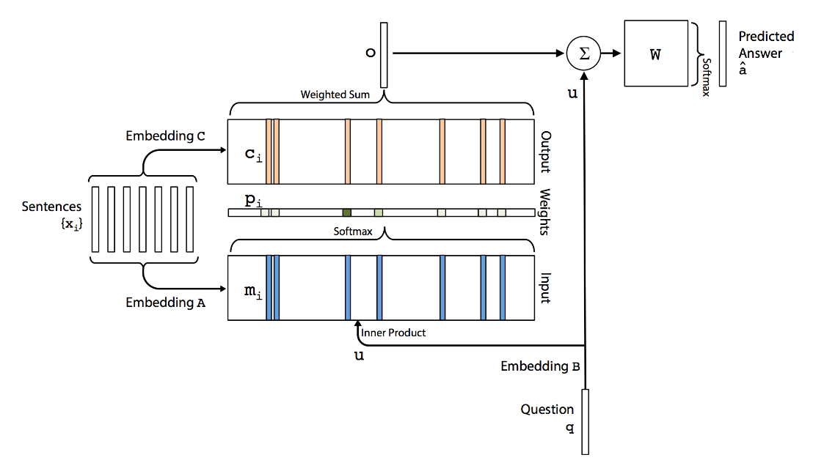




Build The Networks (Encoding)
After vectorized the text content, we build an End to End Network* to encoding the whole corpus before start building the model.
This architecture is a form of Memory Network. But it is trained end-to-end, and hence requires significantly less supervision during training, making it more generally applicable in realistic settings. Hence it can improve the performance of LSTM/RNN.
Input memory representation
Output memory representation
Final Prediction

Slide 7
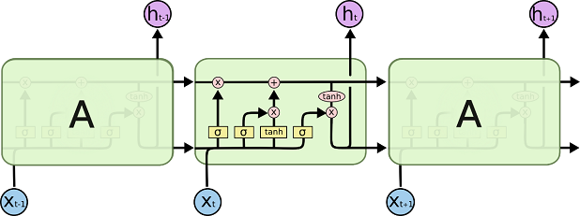
Build LSTM Model
After built the Network to encoding the stories, questions and answers for the model
We build a Long Short-Term Memory (LSTM) networks, which is a type of recurrent neural network (RNN) capable of learning order dependence in sequence prediction problems.

Slide 8
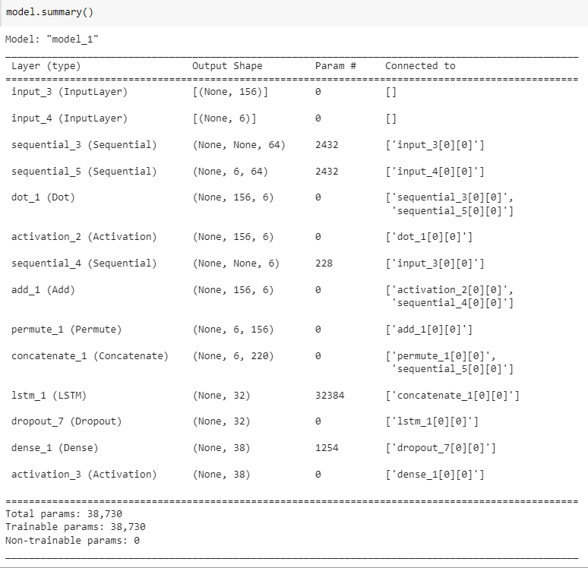
The Final Model

Slide 9
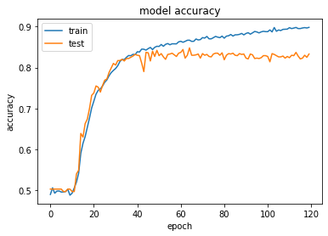
Model Training Performance 80% accuracy

Slide 10
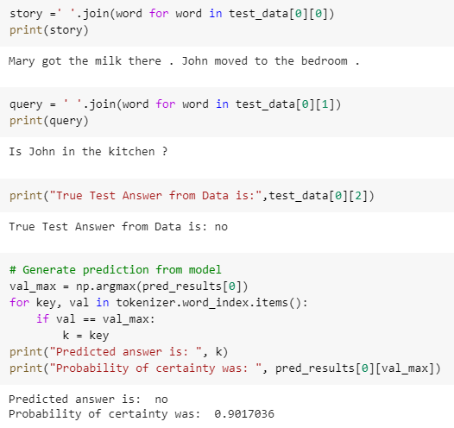
Test Model
Use a case from the original dataset to test the result of the model
We got the correct answer with a confidence of 90.17%

Slide 11
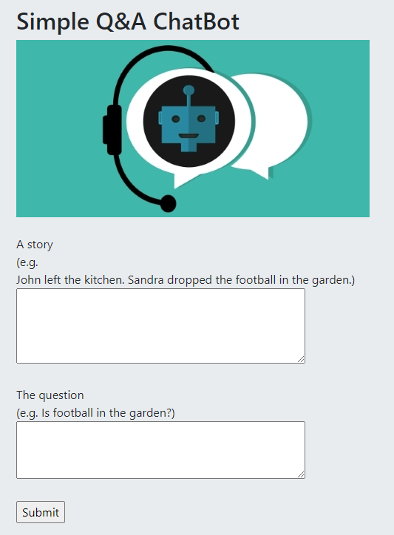

Integrate with Flask
After Training and Testing the model, we save the model to .h5 file and deploy it under a Flask framework.
Achieve let user try the model interactively.
Input the http://127.0.0.1:8080/
to access the model interface

Slide 12
Future Work
Including more training data set, make the model can handle more complex input/case
Improve the model design, so it can perform better even without true label
Hope to deploy the model on AWS/GCP for online inferrence

Slide 13
Reference
Sainbayar Sukhbaatar, Arthur Szlam, Jason Weston, Rob Fergus. 2015. End-to-End Memory Networks. Retrieved from https://research.facebook.com/publications/end-to-end-memory-networks/
Shwetank Sonal. 2020. End-to-End Memory Network : Highlights. Retrieved from https://medium.com/analytics-vidhya/end-to-end-memory-network-highlights-29dba9a6d59b

